Slide 1

Supplier Quality Analysis
This presentation provides an in-depth analysis of supplier performance, focusing on defect quantities, downtime, and quality improvement opportunities. The primary objective is to enhance manufacturing quality by identifying the key drivers of downtime and defects, along with vendor and material performance.

Slide 2

Key Findings
1
Defect Quantity
2
Downtime
The average defect quantity per period is 9166, with over 54 million total defects recorded.
Total downtime across various processes amounted to 138,251 minutes, with logistics contributing the most (55,849 minutes).
3
Vendor Downtime
4
Material Downtime
The vendors contributing the highest downtime are Reddot (26,185 minutes), Sanlab (10,275 minutes), and Plustax (10,270 minutes).
Corrugated materials accounted for the highest downtime, with 52,726 minutes.

Slide 3

Recommendations
Quality Control
Implement stronger quality control measures for incoming raw materials and focus on improving vendor relationships.
Vendor Audits
Regular audits of high-defect vendors, such as Solholdings and Plustax, are essential to reduce recurring quality issues.
Defect Reduction
Target high-impact defect categories (e.g., Mechanicals and Packaging) for significant defect reduction and quality improvement.

Slide 4
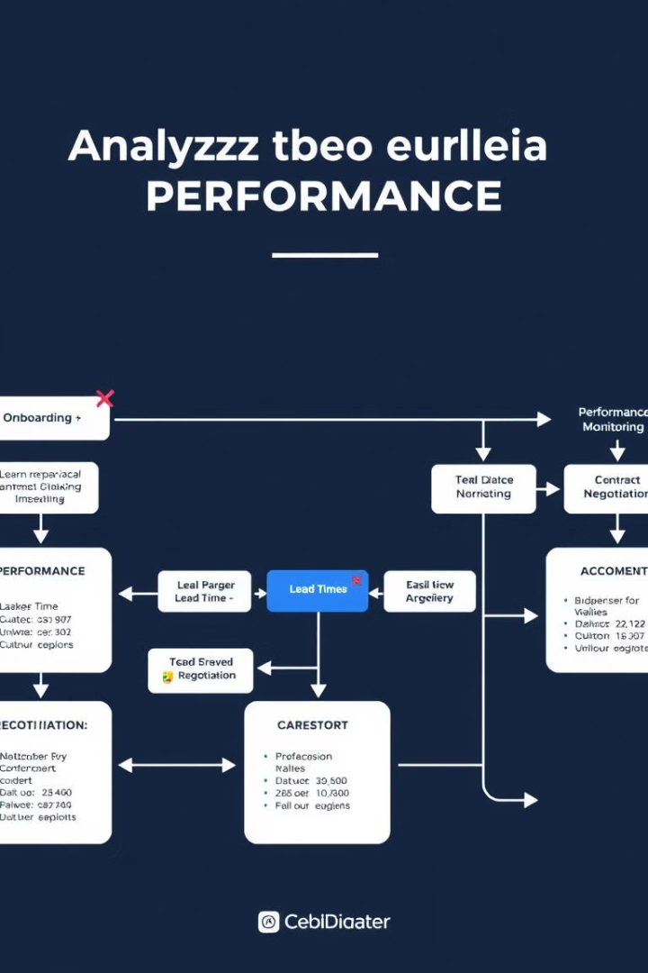
Introduction
The goal of this analysis is to evaluate the defect rates and downtime associated with various suppliers, materials, and production plants, in order to optimize supplier performance, reduce defects, and minimize operational downtime.
The primary challenge is the high rate of defects and downtime observed during production, leading to inefficiencies and quality issues. The project aims to identify critical areas for improvement.
The analysis uses data extracted from various vendor, defect, and plant performance reports, focusing on defect types, vendor contributions, downtime, and material characteristics.

Slide 5
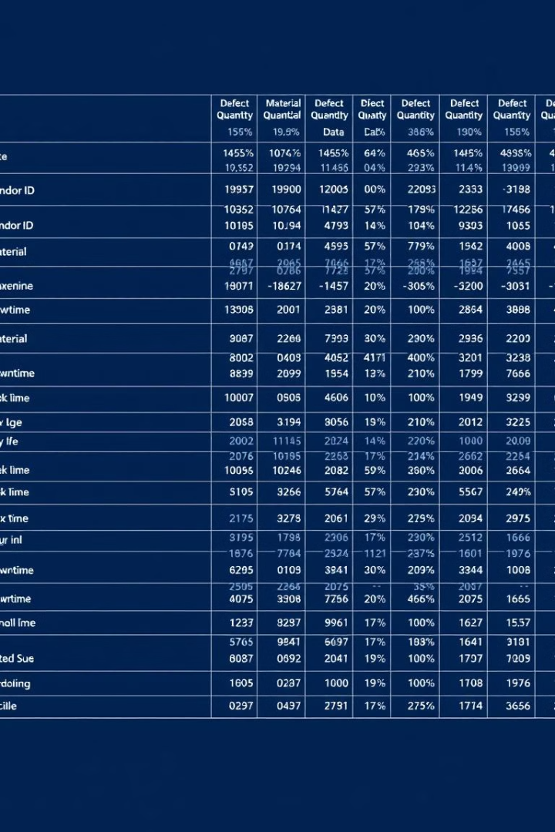
Data Exploration
The dataset includes information from multiple suppliers, plants, and defect categories. The data was preprocessed to remove missing values, and columns related to vendor IDs, material IDs, and defect IDs were dropped for clarity.
The dataset contains 5950 rows, with each row representing a record of defect quantity, downtime, plant, and vendor performance. The dataset includes date fields, categorical variables (e.g., vendor, material type), and numerical fields (e.g., defect quantity, downtime minutes).
Missing values were handled, and irrelevant fields were removed. Time-related fields (month, year) were created to enable time-based analysis.

Slide 6
Data Analysis
Downtime Analysis
Defect Analysis
Vendor Performance
Logistics (55,849 minutes) and Mechanical Issues (34,208 minutes) contributed the highest downtime, with vendors like Reddot and Plustax leading the downtime. The corrugated material type contributed to 52,726 minutes of downtime, followed by raw materials (23,568 minutes).
Defects are primarily categorized as Impact, No Impact, and Rejected, with Impact defects averaging 54.75 minutes of downtime. Solholdings and Plustax were identified as the vendors contributing the highest defect quantities (over 4 million and 3.8 million defects, respectively).
The top 10 vendors with the highest defect quantities accounted for the bulk of the defect issues, with Solholdings and Plustax dominating in terms of defect contribution.

Slide 7
Insights and Recommendations
The majority of defects are caused by mechanical and packaging issues, which combined account for over 60% of total defects. High-impact defects such as misaligned components and improper assembly drive significant quality concerns. Some vendors consistently contribute more defects, indicating the need for more stringent vendor quality control.
Introduce stricter quality checks, particularly for mechanical and packaging processes. Conduct quarterly reviews of high-defect vendors like Solholdings and Plustax to reduce their defect contribution by 20%. Implement predictive maintenance for machinery to reduce mechanical issues and associated downtime.
Focus on improving the handling of raw materials, labels, and films, which contribute heavily to defect rates. Establish a real-time monitoring dashboard for defects and downtime to ensure timely intervention.

Slide 8

Limitations and Future Work
The analysis focuses on historical data and does not incorporate real-time operational conditions that might impact defect rates and downtime. Vendor performance metrics could be further refined by including data on cost and delivery time, offering a more holistic view of performance.
Future analyses should explore the correlation between defect rates and operational factors, such as machine maintenance schedules and employee skill levels. Implementing real-time defect tracking could further reduce defect rates by enabling quicker responses to emerging issues.

Slide 9
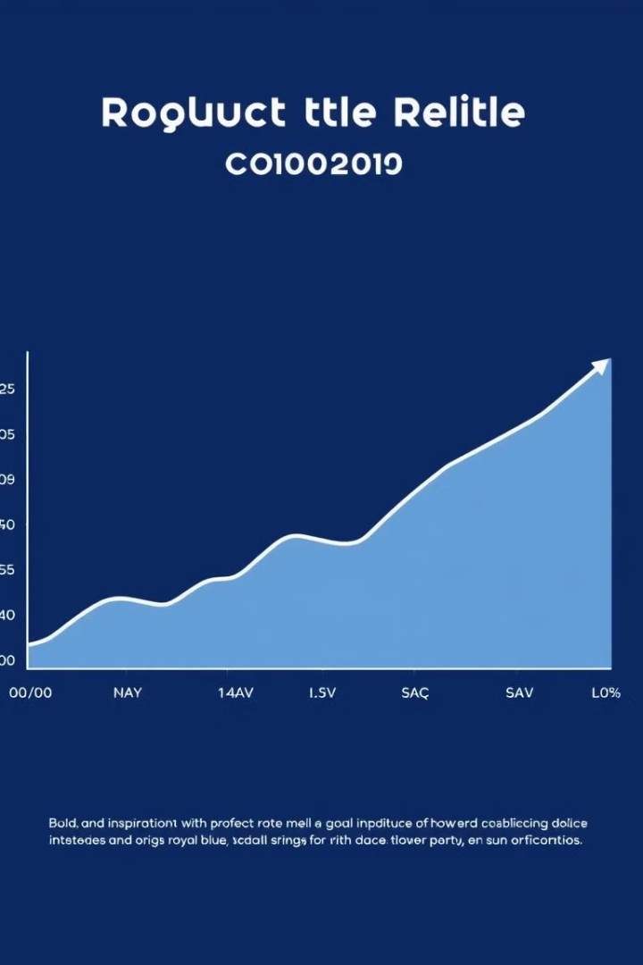
Conclusion
This analysis highlights significant opportunities for improving quality control, reducing downtime, and optimizing supplier performance. By addressing high-impact areas like mechanicals and packaging, and focusing on improving vendor relationships, the company can reduce defect rates by up to 20%, leading to substantial operational savings.
The introduction of real-time monitoring systems is essential for maintaining ongoing improvements and addressing quality issues promptly.

Slide 10

Next Steps
The findings of this report will be presented to key stakeholders, including management, quality assurance teams, and procurement departments. The recommendations will be implemented in a phased approach, with a focus on achieving measurable improvements in quality and efficiency.
Regular monitoring and evaluation will be conducted to track progress and identify any areas requiring further attention. The company is committed to continuous improvement and will leverage this analysis to drive sustainable quality enhancements across its operations.

